Slide 1
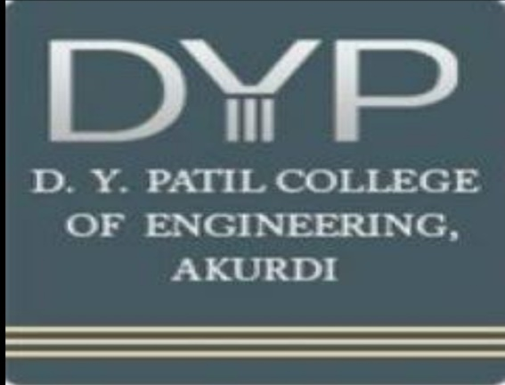
Dr.D.Y Patil college of Engineering ,Akurdi Audit Course (2021-22)
Group member:
Aditya Somani(T150088505)
Vednat Kadam(T150088571)
Omkar Sumbhe(T150088648)
Aditya Khanorkar(T150088577)

Slide 2
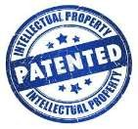
Intellectual Property Rights
2
Intellectual Property is a property that arises from the human intellect. It is a product of human creation. It refers to the creation of the mind: inventions, literacy, designs and artistic works.
Intellectual Property comprises 2 distinct forms:
Literary & Artistic Works(copyright Property)
Industrial Property

Slide 3
“Literacy And Artistic Work”
3
◆ They are books, paintings, musical compositions, plays, movies, radio/tv programs, performances, & other artistic works.
◆ Protected by “COPYRIGHT”

Slide 4
Industrial Property
4
Industrial Property describes physical matter that is the product of an idea or
concept for commercial purposes.
How are they Protected ?
By Trademarks
By Industrial Designs
By Trade Secrets
By Layout-designs

Slide 5
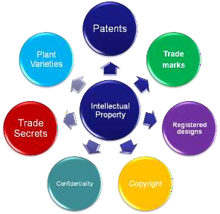
Major Types Of IP
6

Slide 6
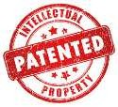
Patents
7
A Patent is a set of exclusive rights granted by a sovereign state to an inventor or assignee for a limited period of time in exchange for detailed public disclosure of an invention
It is covered under the Act called the Patents Act, 1970 [Amended by Patents Act, 2005]
It shall come into force on such date as the Central Government may publish, by notification in the Official Gazette.

Slide 7

Copyright
8
Copyright is a legal right created by the law of a country that grants the creator of an original work exclusive rights to its use and distribution, usually for a limited time, with the intention of enabling the creator to receive compensation for their intellectual effort.
Duration of Copyright:
Copyright in a literary work, lasts for the-
Author’s lifetime plus 50 years from the end of
The calendar year in which the author dies
50 years for films and sound recordings
25 years for typographical arrangements of a published edition

Slide 8

Trademark
10
DEFINITION
A symbol, word, phrase, logo, or combination of these that legally distinguishes one company's product from any others. Any infringement on a trademark is illegal and therefore grounds for the company owning the trademark to sue the infringing party.
The unauthorized usage of trademarks by producing and trading counterfeit consumer goods is known as brand piracy.
The owner of a trademark may pursue legal action against trademark infringement

Slide 9
Protected rights
12
The following rights are protected by Union law:
◆ right of reproduction for authors, performers, producers of phonograms and films and broadcasting organisations.
◆ right of communication to the public for authors, performers, producers of
phonograms and films and broadcasting organisations.
◆ right of fixation for performers and broadcasting organisations.
◆ right of broadcasting for performers, producers of phonograms and
broadcasting organisations
Duration of protection
The rights of authors are protected within their lifetime and for seventy years after their death.
The rights of performers last for 50 years.

Slide 10
CONCLUSION
14
◆ Create yourself, rather than using other’s creations
◆ Do not use competitor’s mark in such way that it harms competitor
in unfair way
◆ No comparisons that are likely to cause confusion

Slide 11
THANK YOU
15

